Slide 1
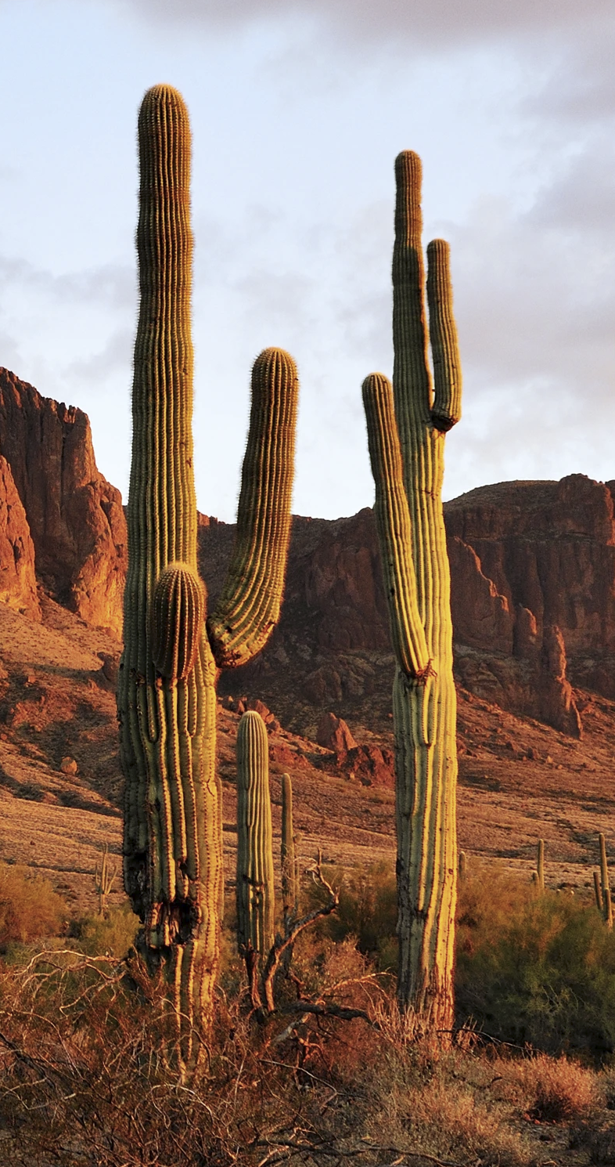
The Project
Parkreation
Where friends gather to talk about national parks of the USA!

Slide 2
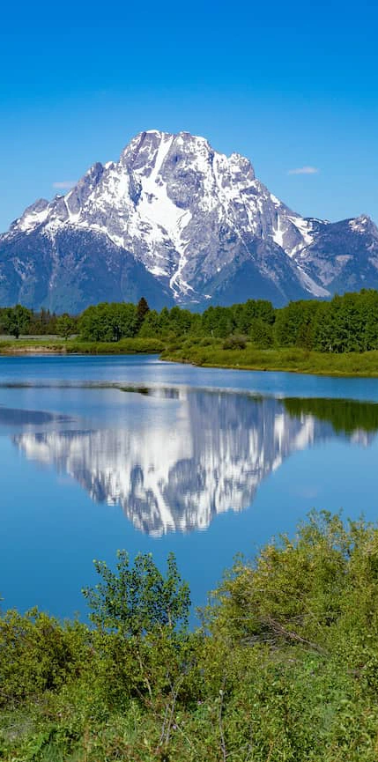
Elevator Pitch
Parkreation is the site where friends go to document their travel to national parks around the USA
Visitors of the website are able to pull parks by state and indicate whether they have visited that park or they want to add it to their wishlist
They can also add comments about a specific park they visited
Visitors must create an account to use Parkreation awesome services and record their memories of parks they visited and parks they wish to visit in their comments
We use PASSPORT package for authentication

Slide 3
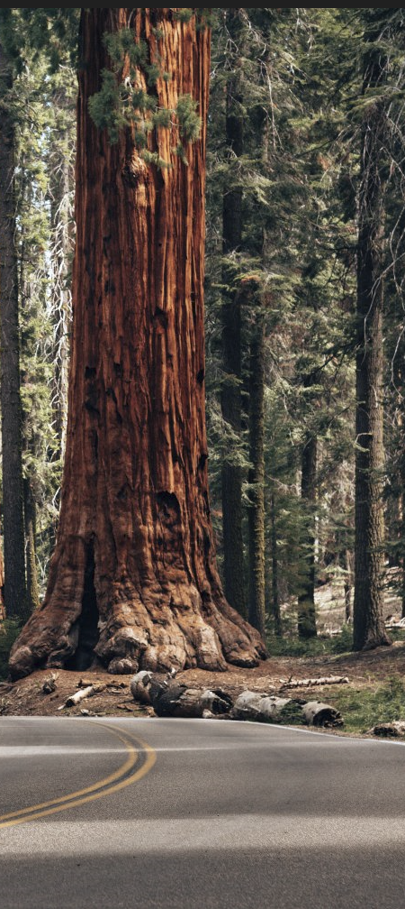

Concept
An easy to navigate site that provides the visitor a pleasant experience by pulling a comprehensive list of parks by state and identify the parks they visited in addition to the parks they plan to visit.
Visitors can also leave their comments about a park
Vistors enjoy a splendid slide show of the national parks of the United State of America!

Slide 4
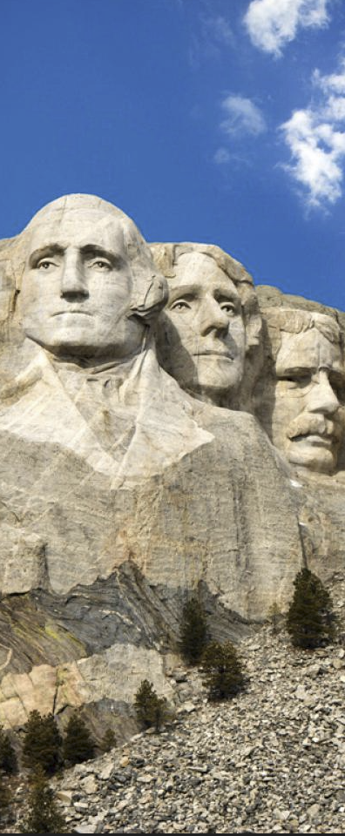
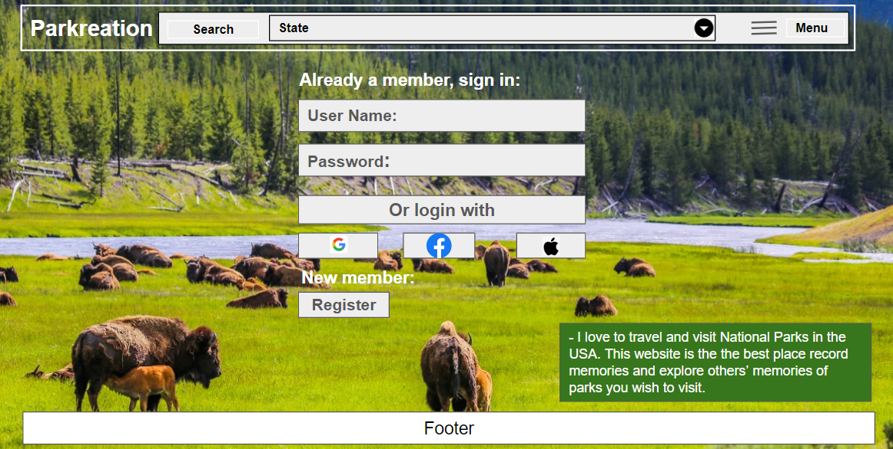
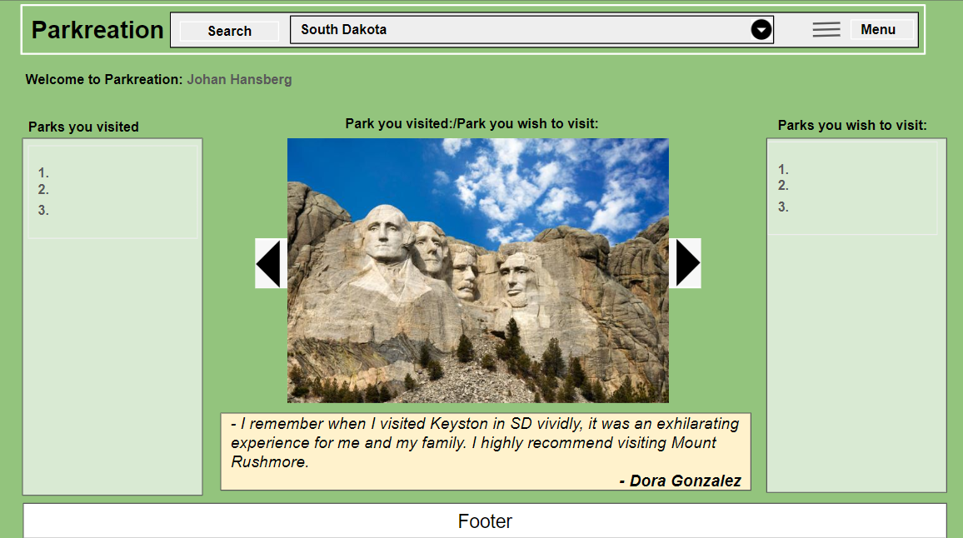
Process
We started with a wireframe…

Slide 5
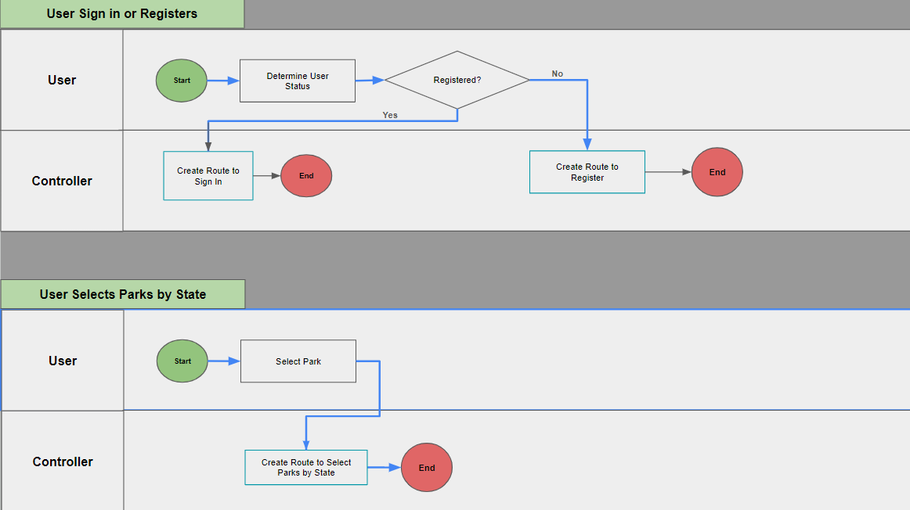
Process
And a few use case process maps to determine routes
Then we created our folder structure for the project

Slide 6
Process
1.Technologies:
Frond-End:
HTML
CSS
Bootstrap
Handlebars for a Template Engine
Back-End:
Bcrypt
passport
express.js
sequelize with postgreSQL
2. Breakdown of tasks and roles:
Backend express server - Dia
Routes - Dia
Presentation/README.md - Alex & Dia
Sequelize - Justin
postgreSQL - Justin
Passport - Justin/Dia
8. Models - Justin/Dia
9. Views - Front-End Alex/Jackson
10. Server Side API - Dameine
11. All team members collaborated on concepts, design and implementation

Slide 7
Process
1. Challenges:
1.1 GitHub
1.2 Render issues
2. Successes:
2.1 Deployed Parkreation successfully
2.2 Created a pleasant slide show of the national parks of the united states.

Slide 8
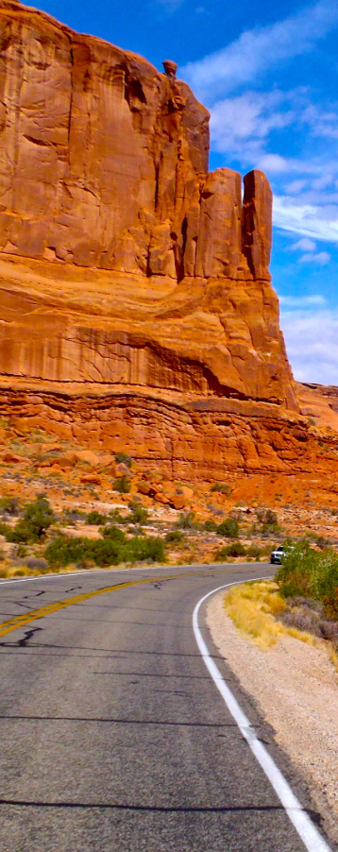
Demo
Visitor sign-in
Validate sign in or prompt to register if fails
Visitor registration
Validate unique user-name
Visitor adds a park to the visited list
Retrieve park from visited list
Visitor adds a park to the wish list
Retrieve park from wish list
Add comment to visited or wish to visit park list
Retrieve comment

Slide 9
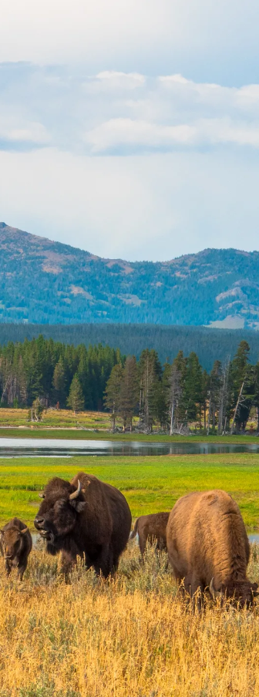
Future Development
Better sign-in failure messages
allow for user-name to be attached to comments
Allow for more services to be planned when visiting
Organize group trips
Allow a community page for chatting about a park and things to do at the park

Slide 10
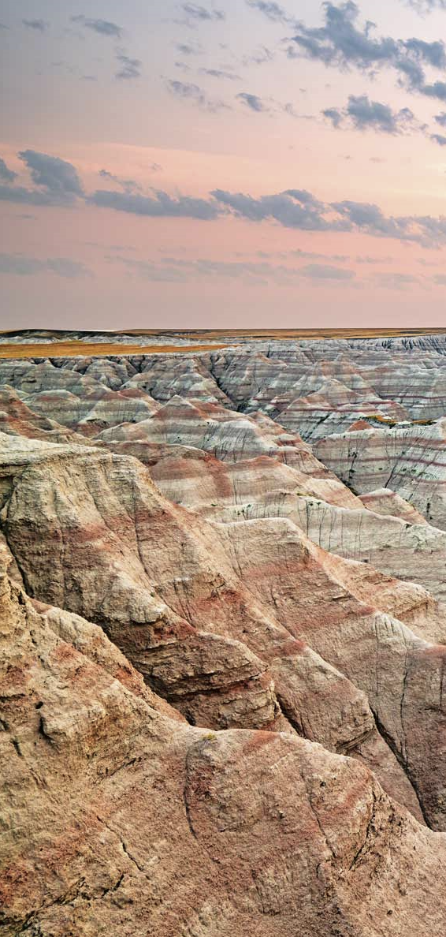
Render
Render Deployment:
https://parkreation.onrender.com
GitHub Repo:
https://github.com/djubara/Parkreation

